Slide 1
Vietnam 1963
South Vietnam President Diem…losing control by 1960
Kennedy scales up US forces…16,000 US trainers
100 US killed/ Situation stabilised
Diem capitalizes on US presence..
Government “family business”, brother Chief Advisor, uncles ministers,
…..brother’s wife Madame Nhu leads domestic policy
Catholic elite vs 70% Buddhist population
Catholics largest landholders, exempt from land reform and taxes
Buddhist monks policy of neutrality…accused of communism
Madame Nhu Imposes puritanical morality laws & Buddhist teachings
Buddhist revolt……shot down by government….Diem blames communists

Slide 2
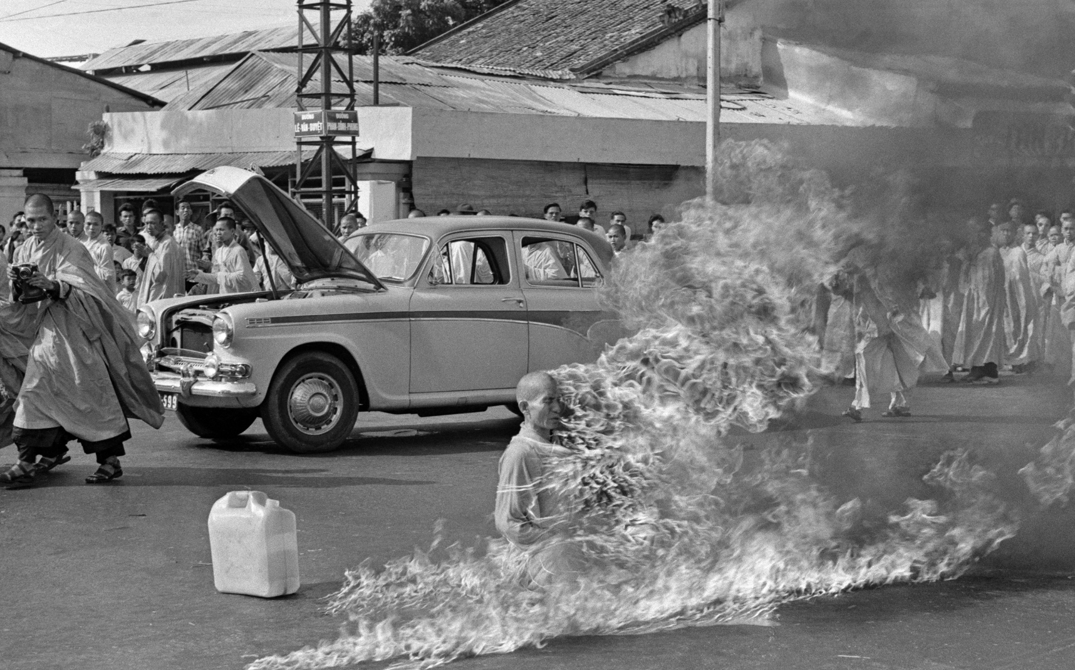
Thich Qang Duc ….monk...prays for toleration…leaves monastery ………informs press of coming “great event”…June 1963

Slide 3
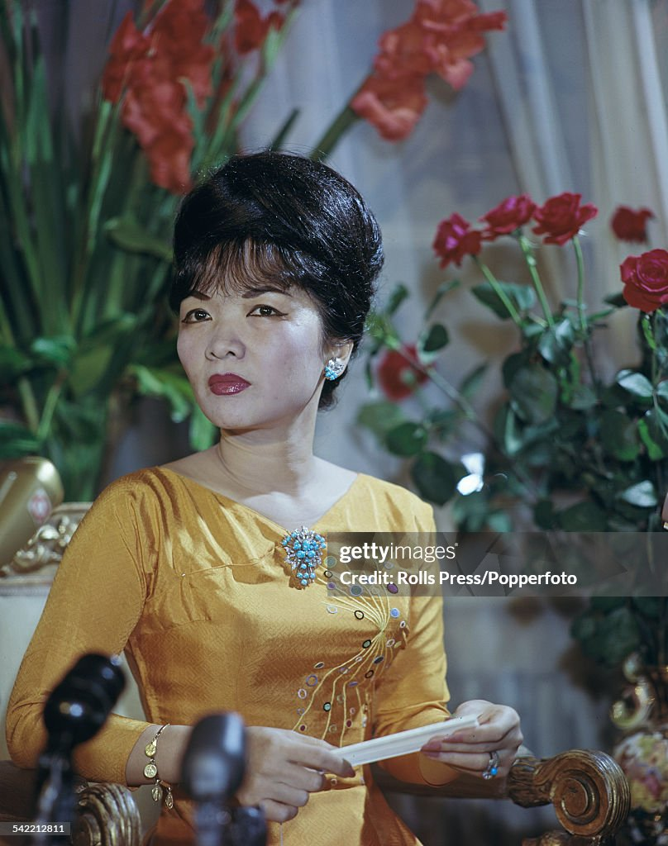
Madame Nhu (1924-2011)
Virulent anti communist…First Lady of Vietnam. Wife of Diem’s brother
Spokesperson for Morality Drive
…flaunts power, publicity drives …US media
Immolation a "barbecue. Let them burn and we shall clap our ands. "barbecuing“
was not "self-sufficient“.. "imported gasoline“
Kennedy: “That goddamn bitch. She's
responsible for the death of that kind man” …..US cannot keep supporting this regime
Most hated person in Vienna: .revolt
Expands…visits US/ Europe defend programme….and shop

Slide 4
Vietnam…change in policy
Kennedy…CIA…support removal of Diem regime…excluding assassination
Army officers engineer coup
US provides Diem and brother $500,000 cash and car to escape
Driver delivers Diem to Army…Diem and brother killed
First of many army generals take command
Plans put in place to scale down US forces….retain financial support
“ In the final analysis, it is their war. They are the ones who have to win it or lose it. We can help them, we can give them equipment, we can send our men out there as advisers, but they have to win it, the people of Vietnam, against the Communists”
CIA opposes…want build up army……occupy Vietnam and win
To be continued

Slide 5
Kennedy & Civil Rights
Promises 1960 campaign not kept
Promises to end segregation at “stroke of a pen”
Does nothing….sent 1000’s pens….since non seem to work in White House
Dilemma: lose White votes in South if he acts….lost world reputation if not
Civil Rights US 1960’s
Martin Luther King…accuses Kennedy of “tokenism”
Widespread discrimination continues
States ignore Federal laws on school, busing, housing
21 state outlaw inter racial marriage
Jim Crow Laws remain…..80% blacks in South cannot vote
Civil Rights mobilise in non violent protest….segregated inter state busing

Slide 6
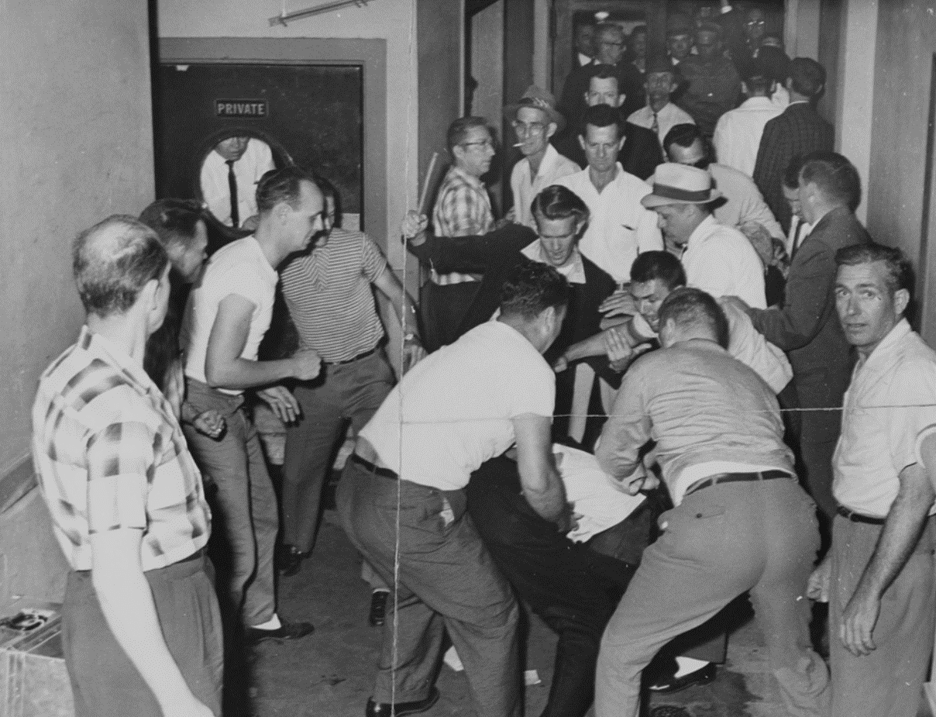
Freedom Riders 1961
White mob beating up Riders
Civil Rights Group (Congress
Of Racial Equality) organise
“rides” in segregated inter
State buses
Buses burned….riders attacked
Kennedy sends National Guard
To protect…deplores violence
Triggers action to develop
New Civil Rights Act…

Slide 7
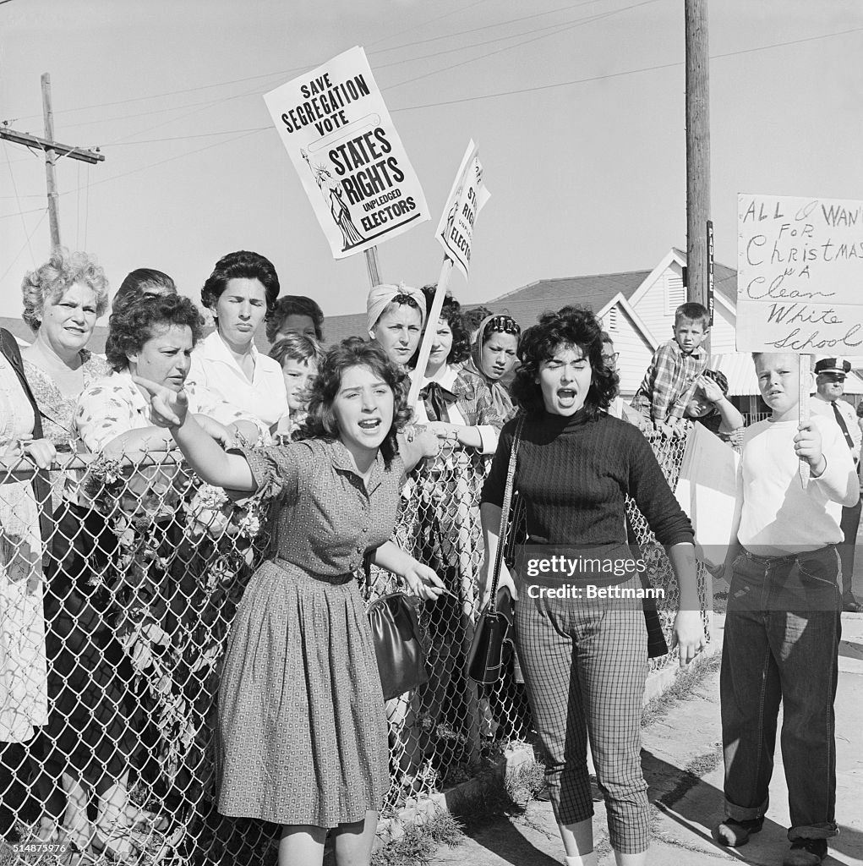
White “save segregation” demonstrations

Slide 8
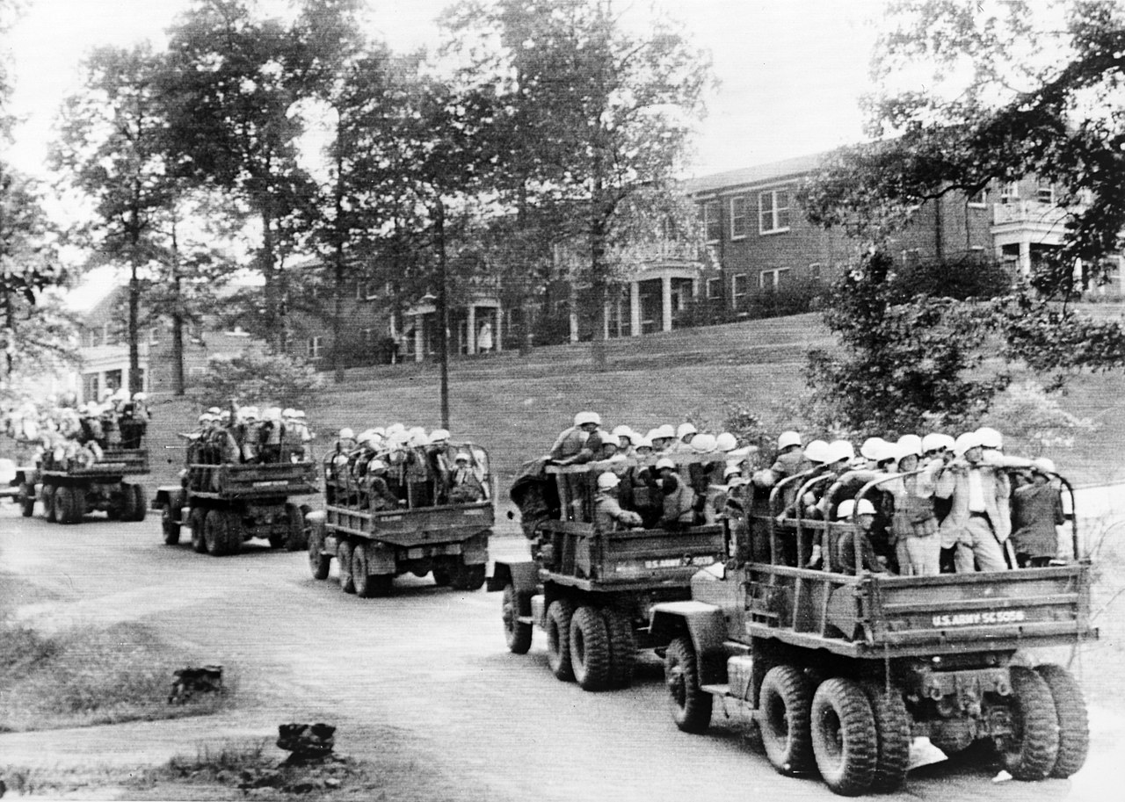
Old Mississippi riot of 1962 …attempted enrolment black student
30,000 national guard sent to enforce Meredith enrolment
University ignores Brown
Supreme Court Ruling
Student attempts to enrol
…disguises race
…attacked
…governor refuses to guard
JFK sends Bobby to negotiate
With Governor…rejected
Kennedy sends troops
…enrolment secured

Slide 9
Civil Rights Act (1964)
Prior legislation ineffective
No enforcement powers
Limited scope
Ignored by “jury amendment”…..local over-rule
Kennedy proposal
Issues “Report to the American People” June 1963
Proposed bill to Congress
Blocked by Southern Democrats….Filibuster
Martin Luther King….proposes grand march to protest

Slide 10
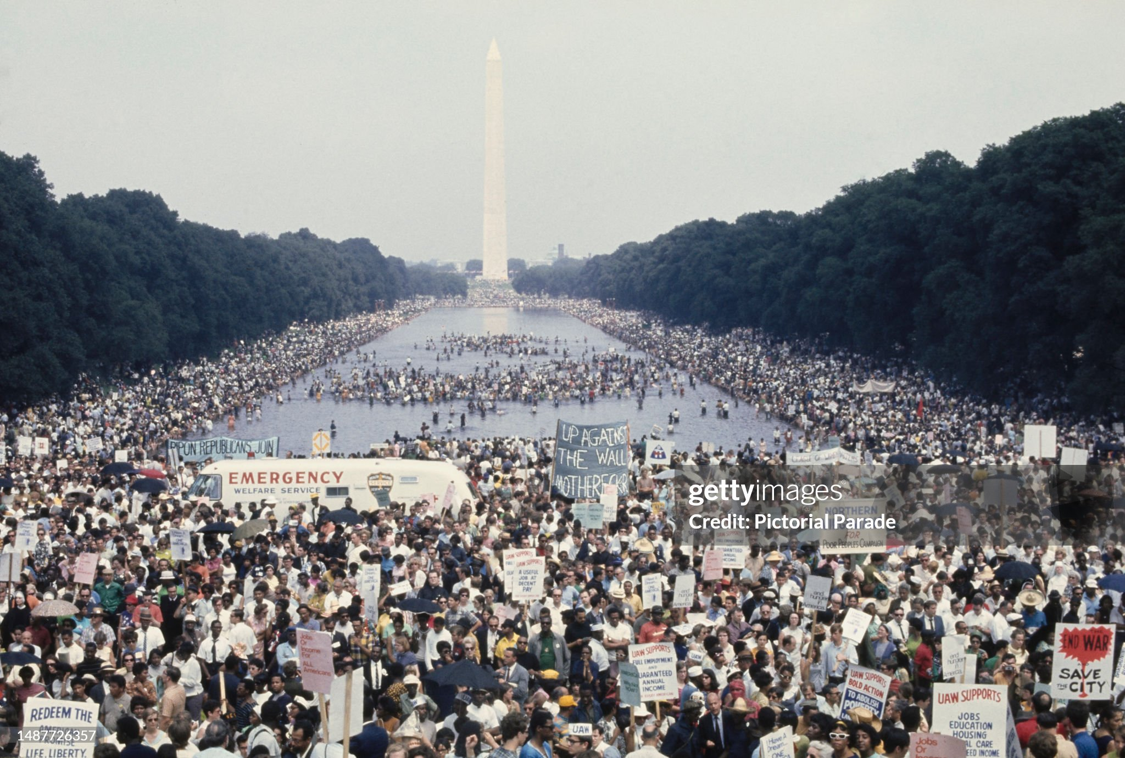
March on Washington Augusts 1963 …MLK leads…250,000 demonstrate

Slide 11
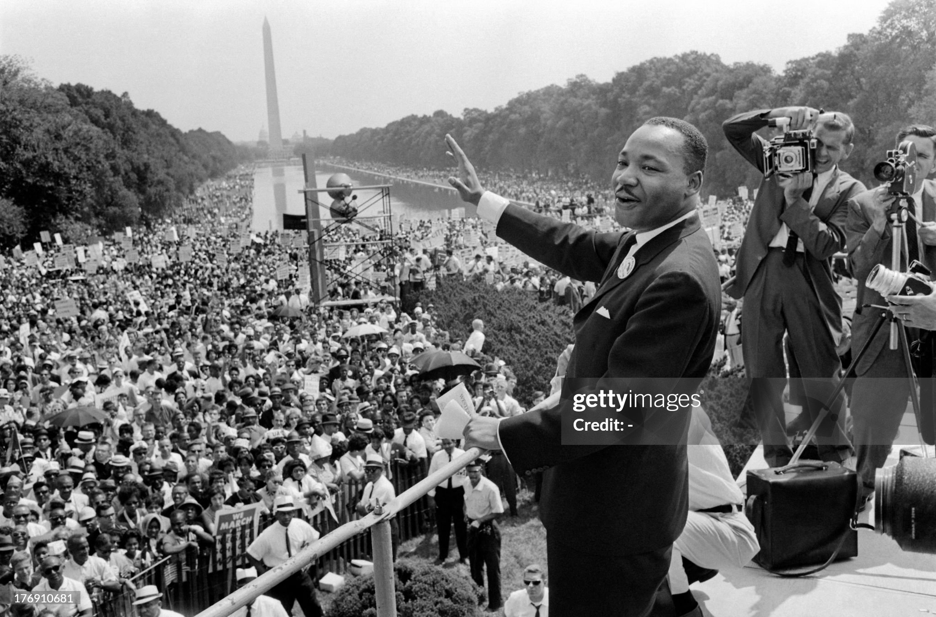
Martin Luther King “I have a dream speech

Slide 12
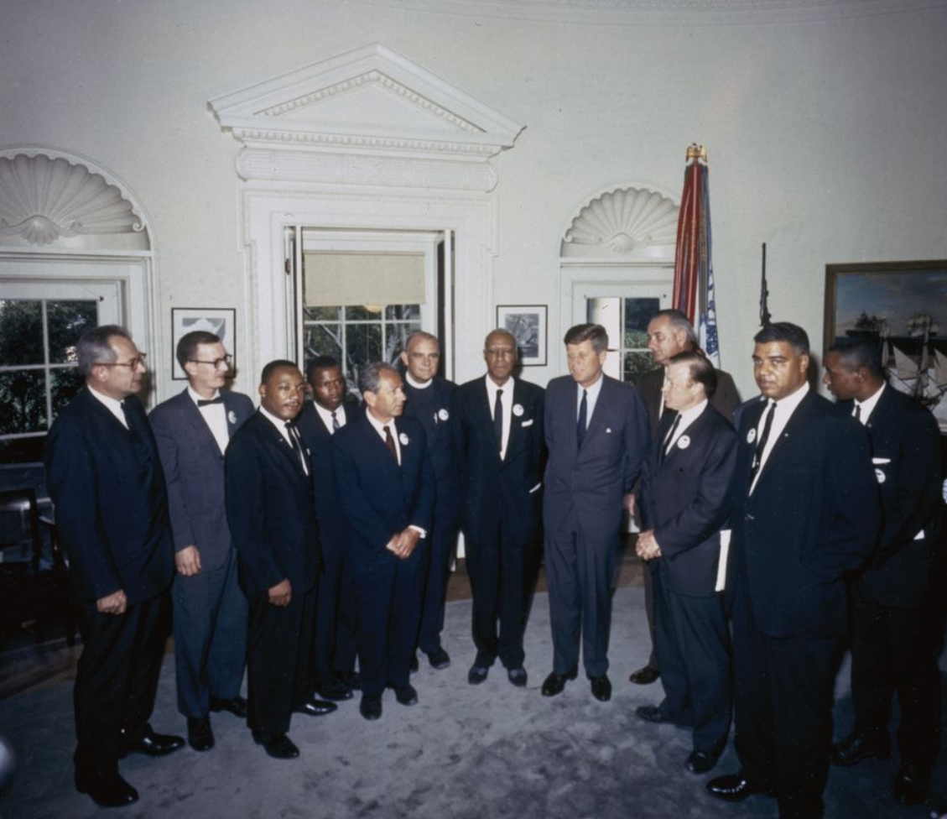
Kennedy meets leaders August 1963 ….commits to Civil Rights legislation ….campaign tour of South with LBJ to promote: advised against
Martin
Luther
King

Slide 13
Kennedy and health issues
“Injected and ingested corticosteroids for his adrenal insufficiency; procaine shots and ultrasound treatments and hot packs for his back; Lomotil, Metamucil, paregoric, phenobarbital, testosterone, and trasentine to control his diarrhea, abdominal discomfort, and weight loss; penicillin and other antibiotics for his urinary-tract infections and an abscess; and Tuinal to help him sleep” (Dr Travelll diary)
Jackie…staff…and JFK…continue to present image of health and virility
…………………….and affairs continue

Slide 14
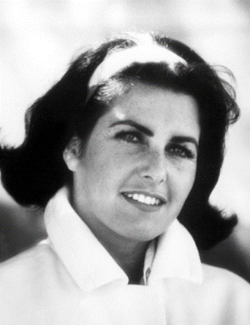
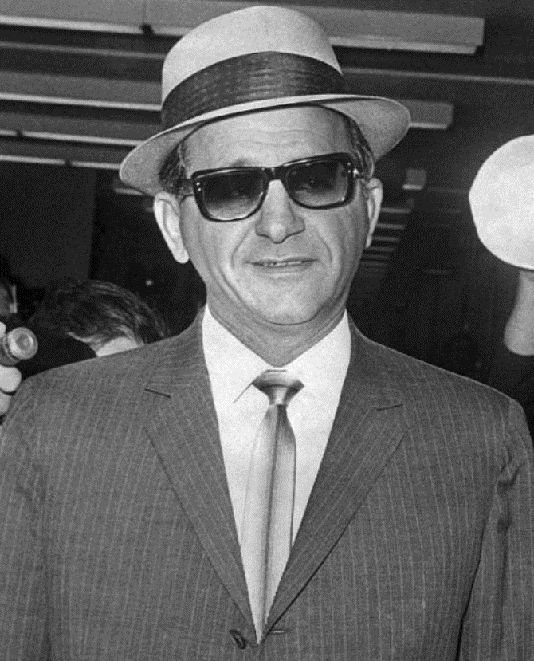
Dangerous Liaisons …Judith Exner….mistress to Mob Sam Giancana

Slide 15
Ellen Rometsch ….German…model…hostess. Married to German army…East German connections…no proof spy…but later expelled….. … …

Slide 16
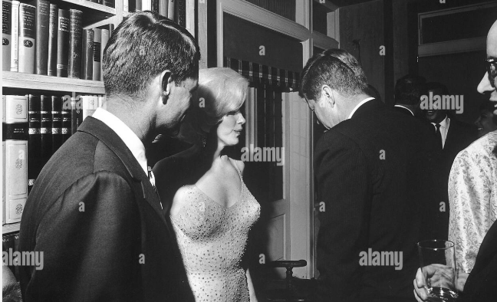
Marilyn Monroe
Introduced to Kennedy 1962
…birthday party
“Affair” denied
Phone call to Jackie….recalled by ‘friend”
For People Magazine
“Marilyn, you'll marry Jack, that's great
... and you'll move into the White House
and you'll assume the responsibilities of
first lady, and I'll move out and you'll have
all the problems” As quoted “These
Few Precious Days”…Christopher Andersen

Slide 17
Last Days

Slide 18
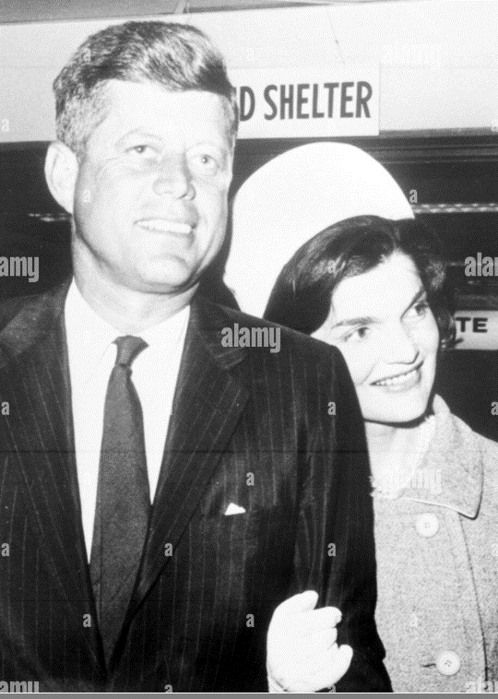
…..yet
August 24 1963…Jackie 36 weeks pregnant premature labour
…..Patrick respiratory illness
…..JFK airlifted from White House to hospital
……Sleeps on couch in hospital boiler room
…..Patrick dies 37 hours
Leaving hospital
John and Jackie….into mourning….both
devastated……witnesses
…never seen them so caring for each other.
Kennedy commits $2m fund for respiratory
illness in Premature babies

Slide 19
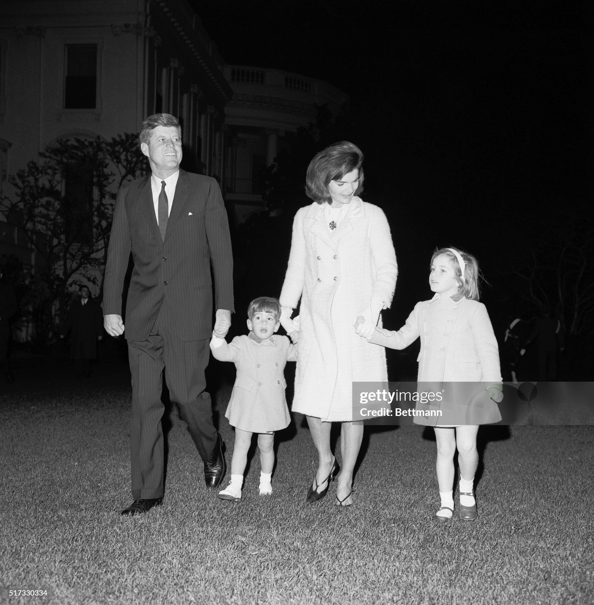
John & Jackie with two children …a few days before trip to Texas

Slide 20
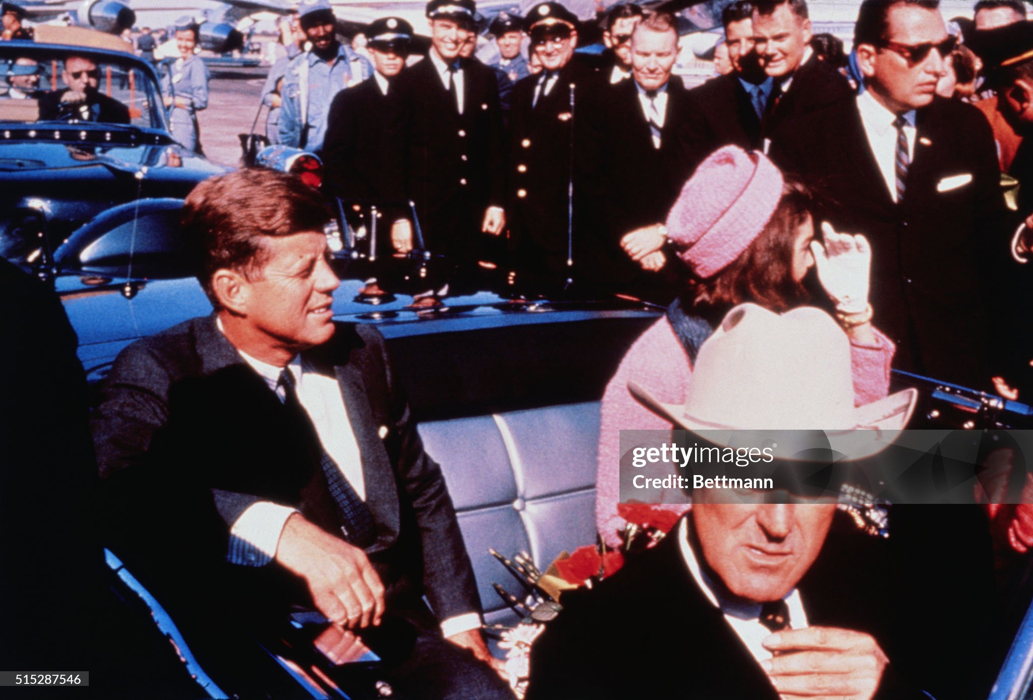
JFK agrees trip to Texas to promote Civil Rights Bill …Jackie still in mourning over death of Patrick

Slide 21
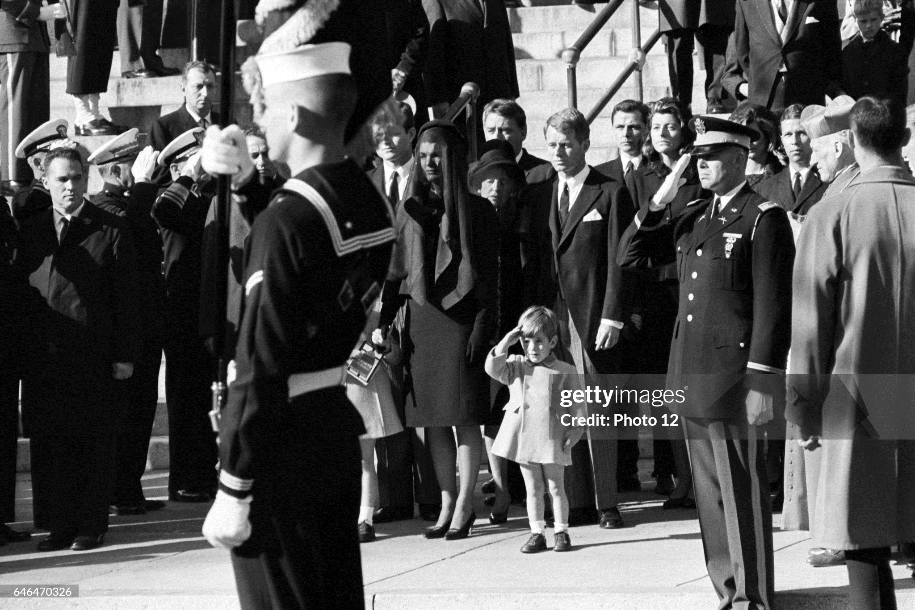
World mourns….future hope extinguished

Slide 22
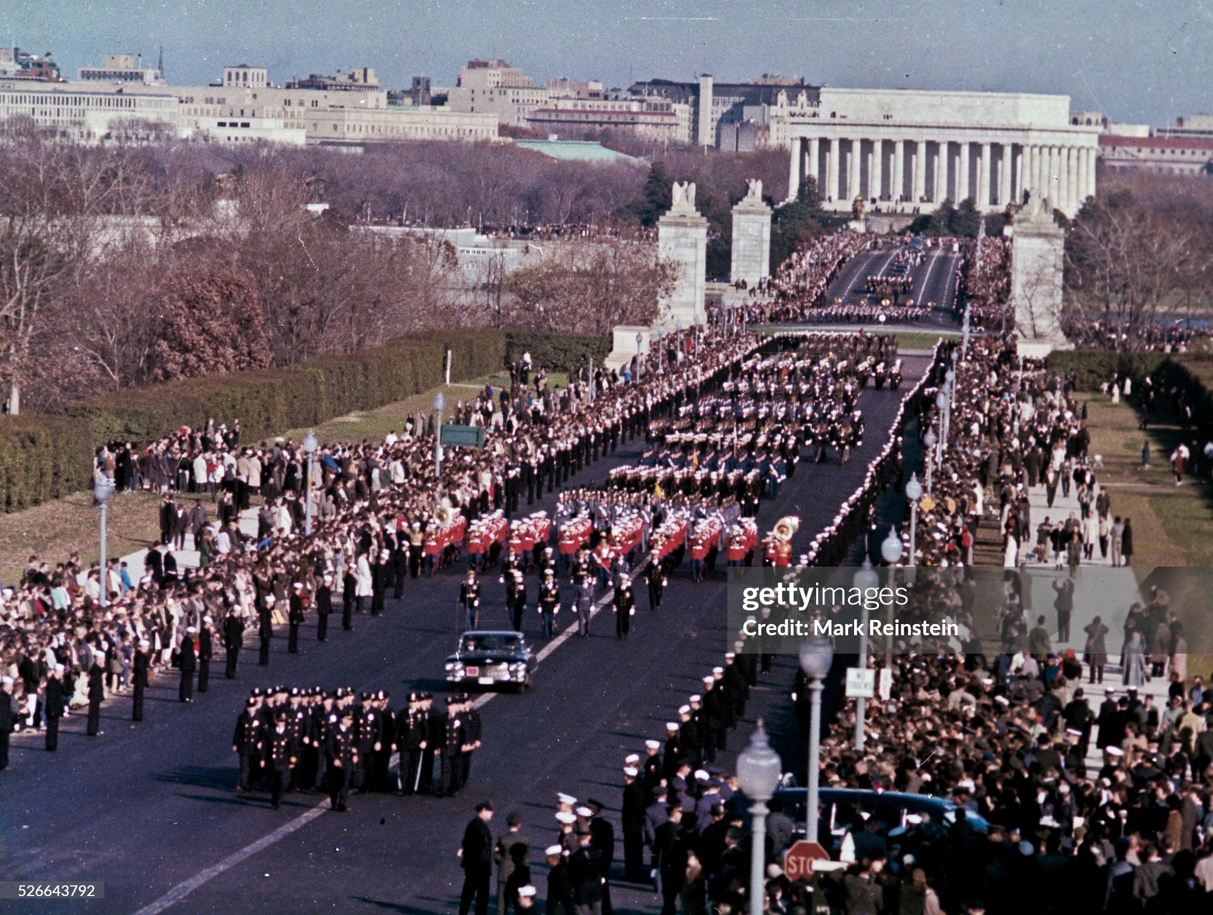

Slide 23
A President’s work is never done.
His burdens press from sun to sun
A Berlin Wall, a racial brew
A tax cut bill, a Madame Nhu
One crisis ebbs, another flows
…and here comes John with runny nose
A President must rise and dress
See senators, and meet the press
Be always bold, be sometimes wary
Be kind to foreign dignitary
And while he fends off many foes
…Bend down and wipe a little boy’s nose
NY Editor E B White

